Slide 1
Linked Structures
Lecture # 6

Slide 2
Introduction
An array is the most basic sequence container used to store and access a collection of data.
The Python list, which is also a sequence container, is an abstract sequence type implemented using an array structure.
They both store data in linear order and provide easy access to their elements.
But there are several disadvantages in the use of the array and Python list.
Insertion and deletion operations typically require items to be shifted to make room or close a gap.
The size of an array is fixed and cannot change.
The Python list does provide for an expandable collection, that expansion does not come without a cost.
the elements of an array are stored in contiguous bytes of memory, no matter the size of the array.

Slide 3
Linked List data structure
A general-purpose structure that can be used to store a collection in linear order.
Improves on the construction and management of an array and Python list by requiring smaller memory allocations and no element shifts for insertions and deletions.
It does eliminate the constant time direct element access available with the array and Python list.
There are several varieties of linked lists.
singly linked list
circularly linked
doubly linked list
circularly doubly linked list

Slide 4
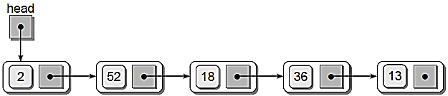
Linked List data structure
A linked structure contains a collection of objects called nodes, each of which contains data and at least one reference or link to another node.
A linked list is a linked structure in which the nodes are connected in sequence to form a linear list.
The last node in the list, commonly called the tail node, is indicated by a null link reference.

Slide 5
Linked List data structure
Linked structures are built using fundamental components provided by the programming language, namely reference variables and objects.
The linked list is just one of several linked structures that we can create.
A linked list is a data structure that can be used to implement any number of abstract data types.

Slide 6

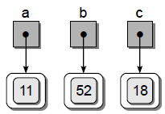

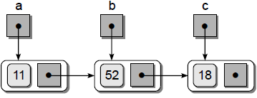
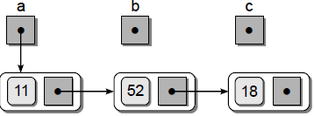
Linked List data structure
a.next = b
b.next = c

Slide 7
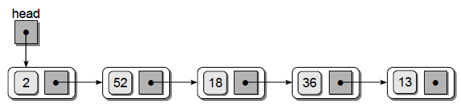
The Singly Linked List
A singly linked list is a linked list in which each node contains a single link field and allows for a complete traversal from a distinctive first node to the last.
Traversing a linked list requires the initialization and adjustment of a temporary external reference variable.

Slide 8
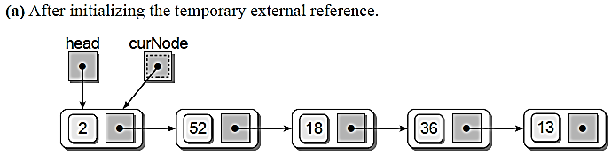
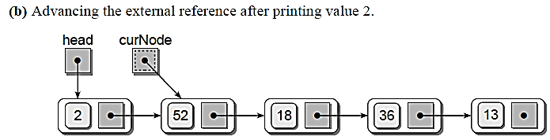
The Singly Linked List

Slide 9
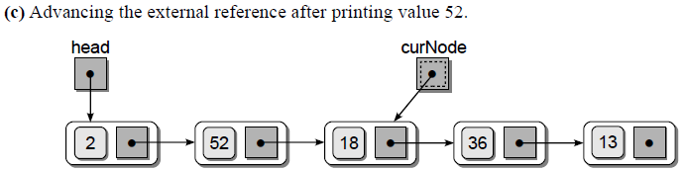
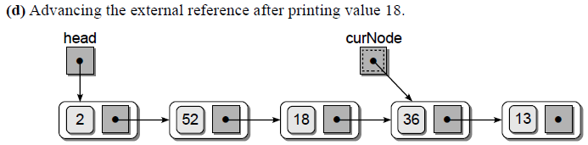
The Singly Linked List

Slide 10
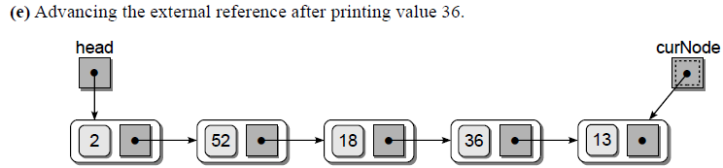
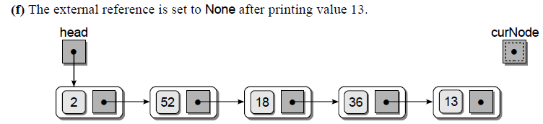
The Singly Linked List

Slide 11
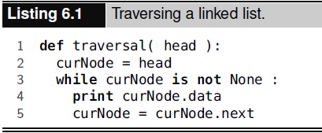
Traversing a linked list

Slide 12
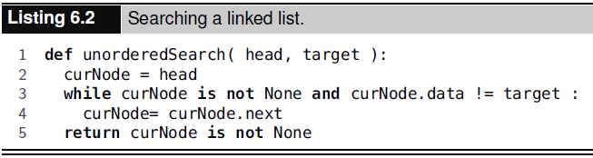
Searching a linked list

Slide 13
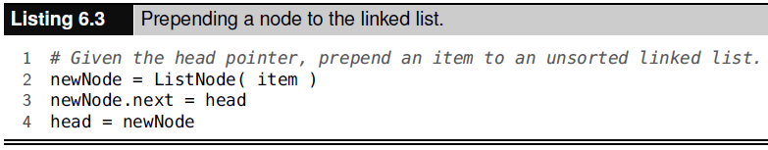
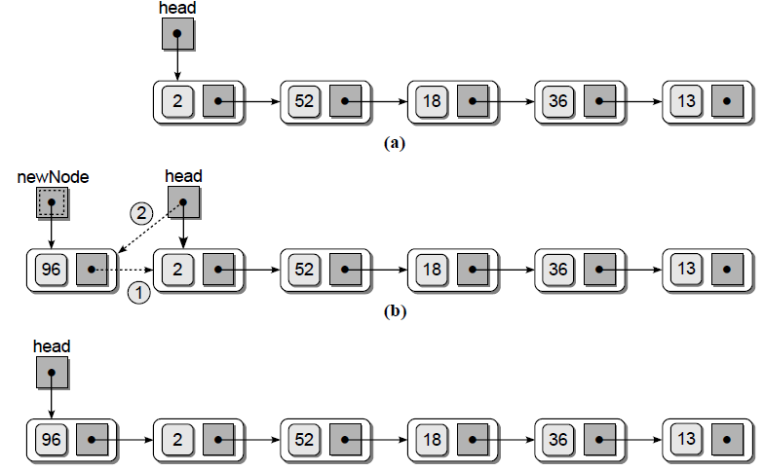
Prepending Nodes

Slide 14
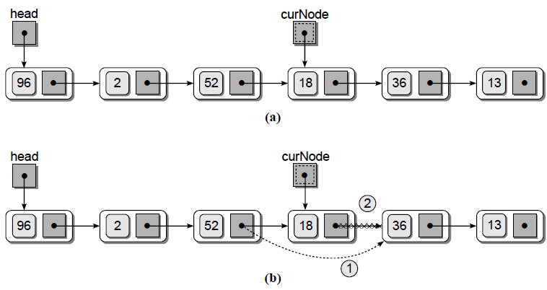
Removing Nodes

Slide 15
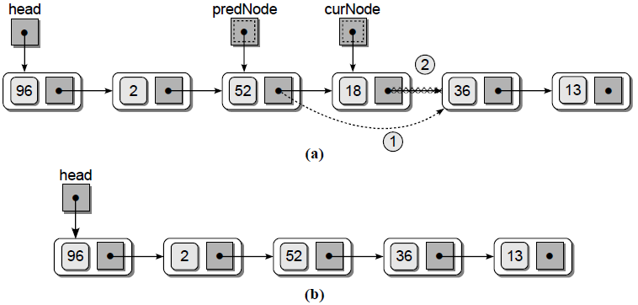
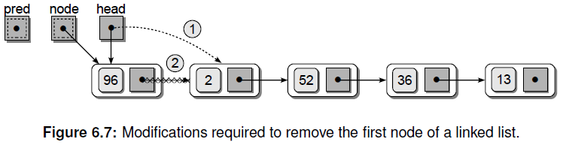
Removing Nodes

Slide 16
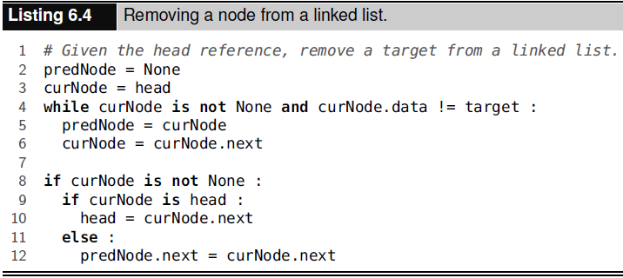
Removing Nodes

Slide 17
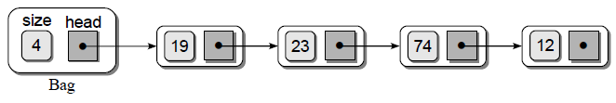
The Bag ADT Revisited - A Linked List Implementation

Slide 18
#implements Bag ADT using a linkedlist class Bag: def __init__(self): self._head = None self._size = 0 def __len__(self): return self._size def __contains__(self,target): curNode = self._head while curNode is not None and curNode.item != target: curNode = curNode.next return curNode is not None def add(self, item): newNode = _BagListNode(item) newNode.next = self._head self._head = newNode self._size += 1
def remove(self, item): predNode = None curNode = self._head while curNode is not None and curNode.item != item: predNode = curNode curNode = curNode.next assert curNode is not None, "The item must be in the bag!" self._size -= 1 if curNode is self._head: self._head = curNode.next else: predNode.next = curNode.next return curNode.item def __iter__(self): return _BagIterator(self._head)
class _BagListNode(object): def __init__(self, item): self.item = item self.next = None

Slide 19
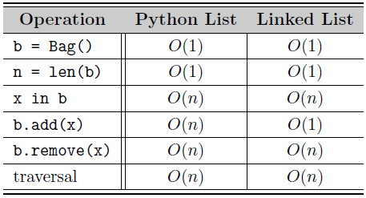
Comparing Implementations

Slide 20
The Bag ADT Revisited - A Linked List Implementation
class _BagIterator: def __init__(self, listHead): self._curNode = listHead def __iter__(self): return self def __next__(self): if self._curNode is None: raise StopIteration else: item = self._curNode.item self._curNode = self._curNode.next return item def next(self): return self.__next__()

Slide 21
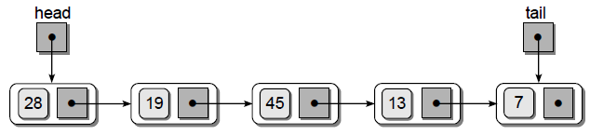
More Ways to Build a Linked List
Using a Tail Reference
The use of a single external reference to point to the head of a linked list is sufficient for many applications.
In some instances, however, we may need to append items to the end of the list instead.
Instead of a single external head reference, we can use two external references, one for the head and one for the tail.

Slide 22
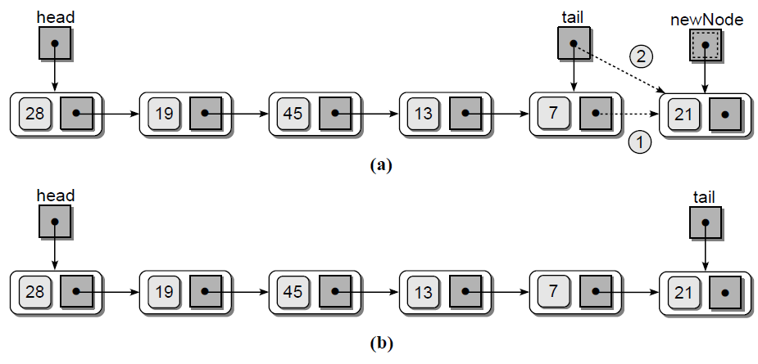
Using a Tail Reference
Appending Nodes

Slide 23
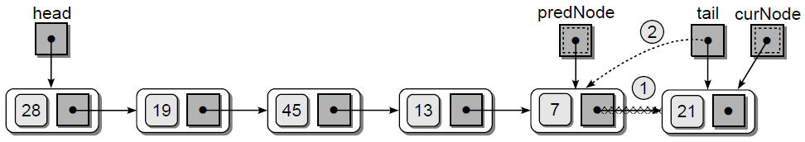
Using a Tail Reference
Removing Nodes

Slide 24
Using a Tail Reference
Appending Nodes
Removing Nodes
def remove(self, item): predNode = None curNode = self._head while curNode is not None and curNode.item != item: predNode = curNode curNode = curNode.next assert curNode is not None, "The item must be in the bag!" self._size -= 1 if curNode is not None: if curNode is self._head: head = curNode.next else: predNode.next = curNode.next if curNode is self._tail: self._tail = predNode return curNode.item
def add(self, item): newNode = _SinglyListNode(item) if self._head is None: self._head = newNode else: self._tail.next = newNode self._tail = newNode self._size += 1

Slide 25
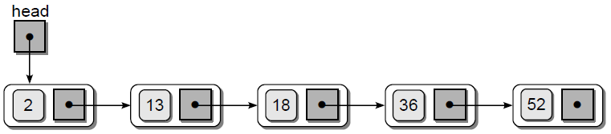
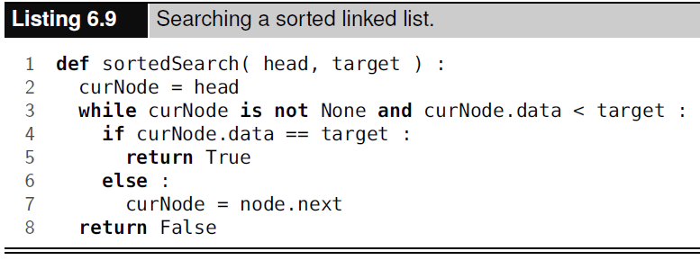
The Sorted Linked List

Slide 26
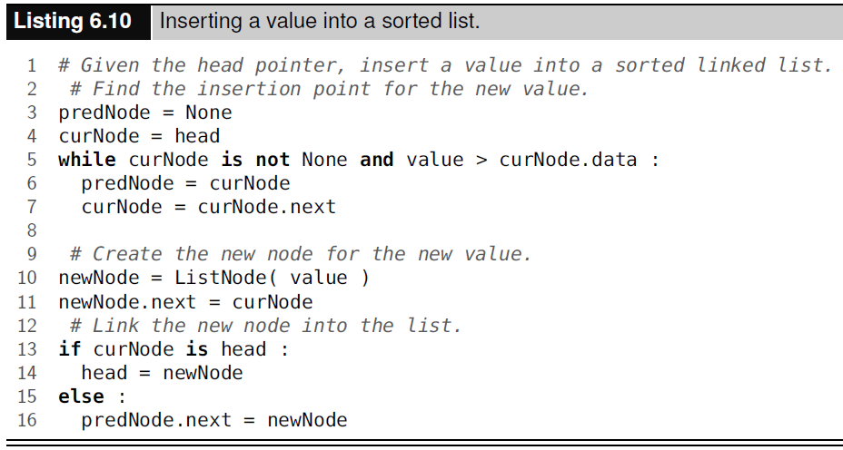
The Sorted Linked List

Slide 27
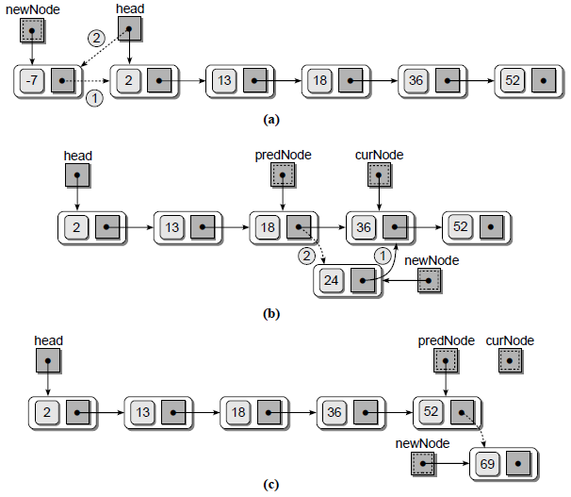
The Sorted Linked List
Case 1: the node is inserted in the front
Case 2: the node is inserted somewhere in the middle position
Case 3: the node is inserted at the end

Slide 28
The Sparse Matrix Revisited
Now improve the previously implemented Sparse Matrix ADT by using the linked list structure.
Use an array of sorted linked lists, one for each row of the matrix.
The non-zero elements for a given row will be stored in the corresponding linked list sorted by column index.
The row index is not needed since it corresponds to a specific linked list within the array of linked lists.

Slide 29
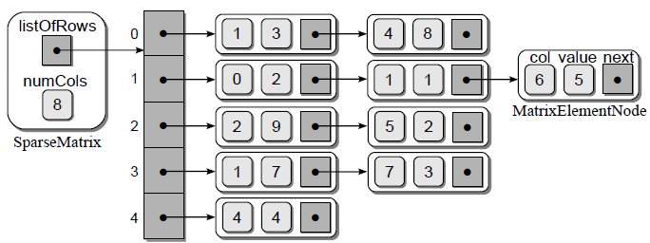
The Sparse Matrix Revisited

Slide 30
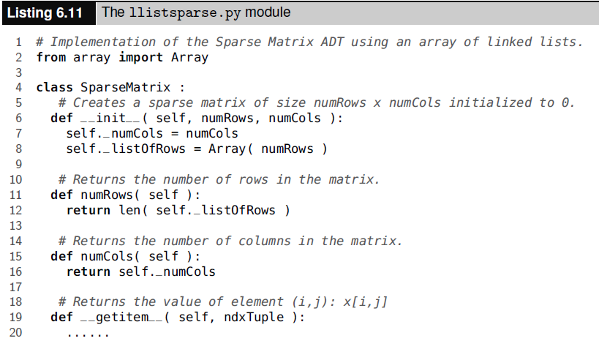
The Sparse Matrix Revisited

Slide 31
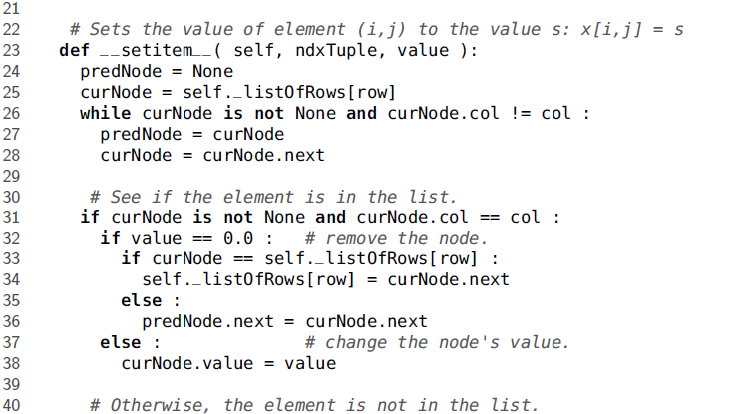
The Sparse Matrix Revisited

Slide 32

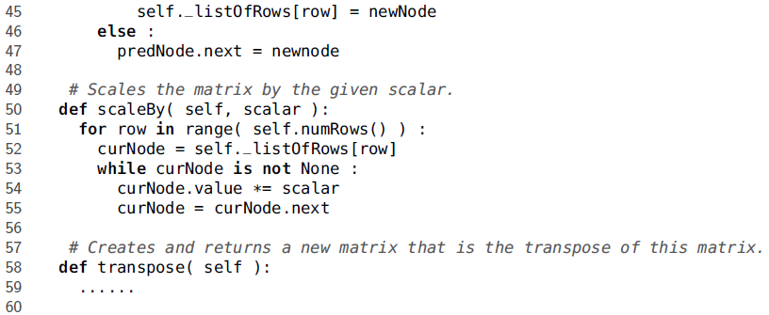
The Sparse Matrix Revisited

Slide 33
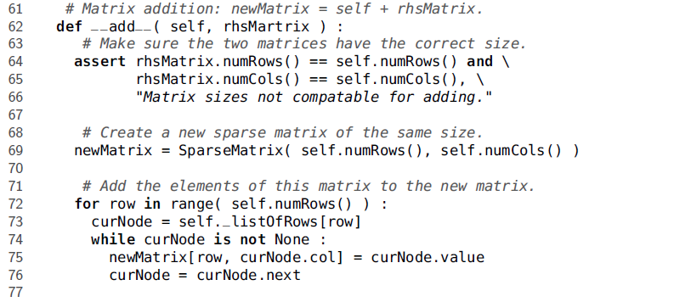
The Sparse Matrix Revisited

Slide 34
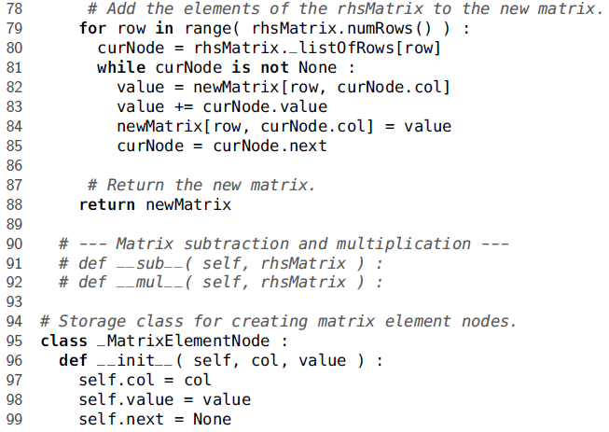
The Sparse Matrix Revisited

Slide 35
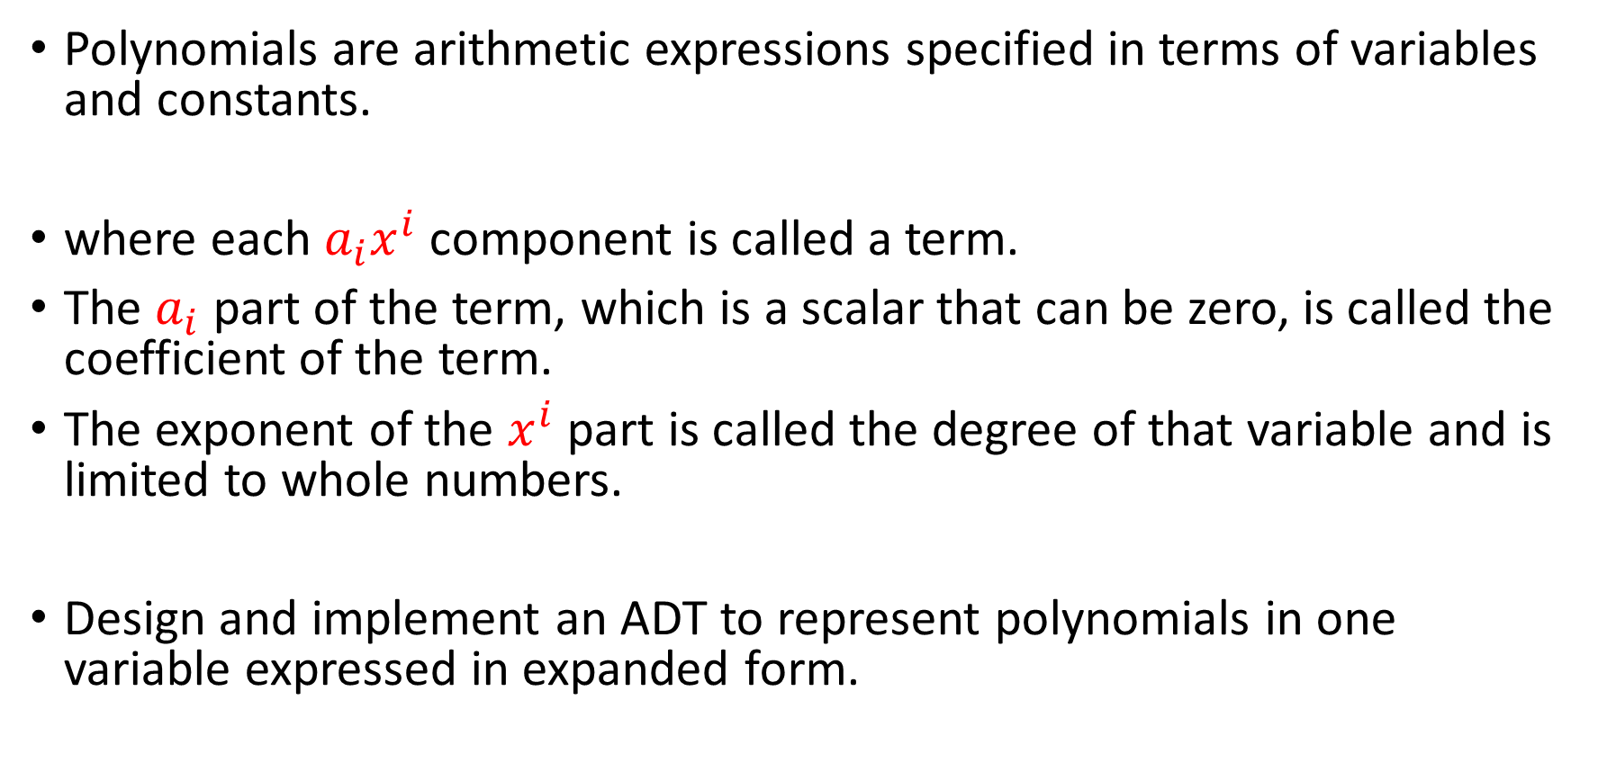

Application: Polynomials
Polynomials are arithmetic expressions specified in terms of variables and constants.
where each $a_{i}x^{i}$ component is called a term.
The $a_{i}$ part of the term, which is a scalar that can be zero, is called the coefficient of the term.
The exponent of the $x^{i}$ part is called the degree of that variable and is limited to whole numbers.
Design and implement an ADT to represent polynomials in one variable expressed in expanded form.
$$a_{n}x^{n}+a_{n−1}x^{n−1}+a_{n−2}x^{n−2}+…+a_{1}x^{1}+a_{0}$$
$$12x^{2}−3x+7$$

Slide 36
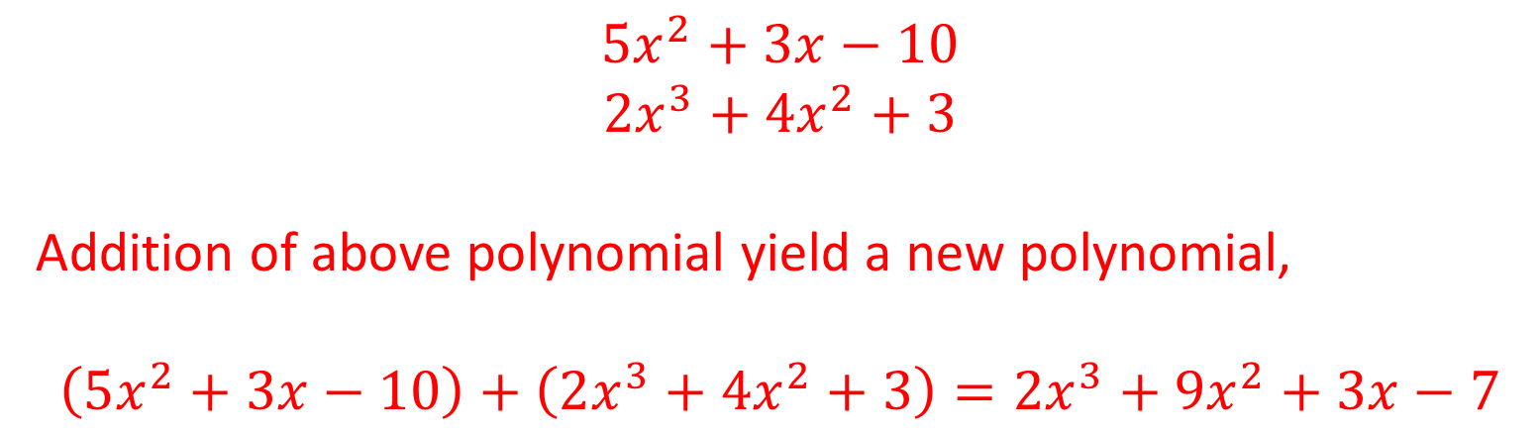
Application: Polynomials
Operations
Addition
$$5x^{2}+3x−10$$
$$2x^{3}+4x^{2}+3$$
Addition of above polynomial yield a new polynomial,
$$\left(5x^{2}+3x−10\right)+\left(2x^{3}+4x^{2}+3\right)=2x^{3}+9x^{2}+3x−7$$

Slide 37
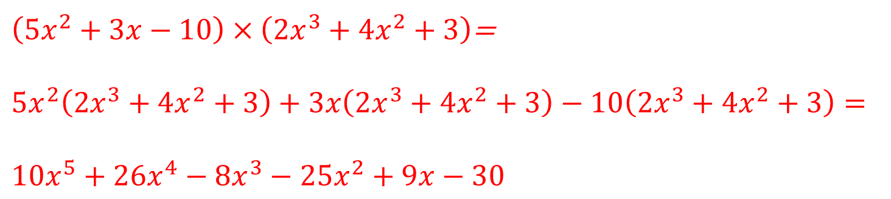
Application: Polynomials
Operations
Multiplication
$\left(5x^{2}+3x−10\right)×\left(2x^{3}+4x^{2}+3\right)$=
$$5x^{2}\left(2x^{3}+4x^{2}+3\right)+3x\left(2x^{3}+4x^{2}+3\right)−10\left(2x^{3}+4x^{2}+3\right)=$$
$$10x^{5}+26x^{4}−8x^{3}−25x^{2}+9x−30$$

Slide 38
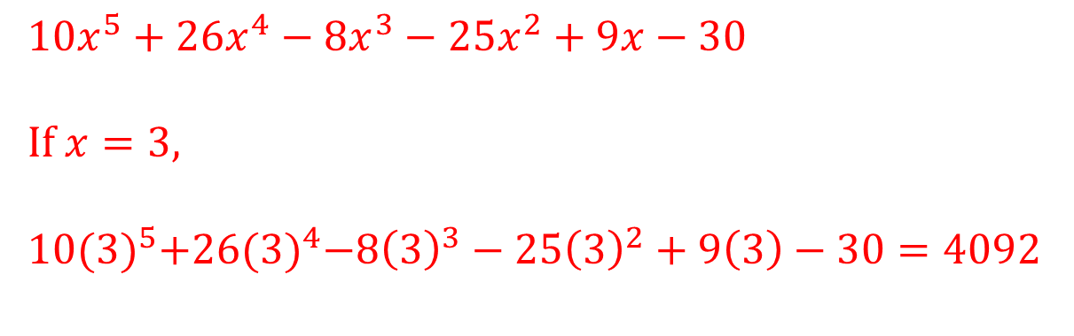
Application: Polynomials
Operations
Evaluation
$$10x^{5}+26x^{4}−8x^{3}−25x^{2}+9x−30$$
If $x=3,$
$$10{(3)}^{5}+26{(3)}^{4}−8{\left(3\right)}^{3}−25{\left(3\right)}^{2}+9\left(3\right)−30=4092$$

Slide 39
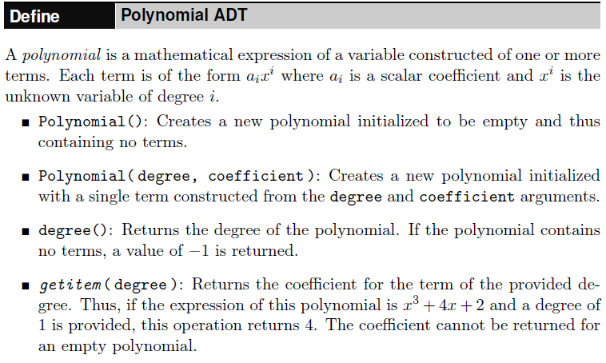
The Polynomial ADT

Slide 40
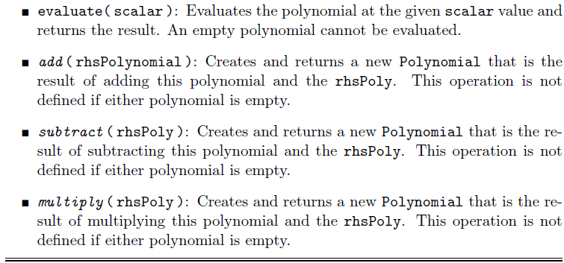
The Polynomial ADT

Slide 41
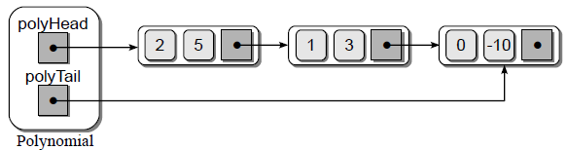

Polynomial : Implementation
Can our implementation benefit from the use of a tail pointer or if a head pointer alone will sufficient?
The implementation of some of our polynomial operations can be improved if we append nodes directly to the end of the linked list.
Thus, we will use and manage a tail pointer in our implementation of the Polynomial ADT.
$$5x^{2}+3x−10$$

Slide 42
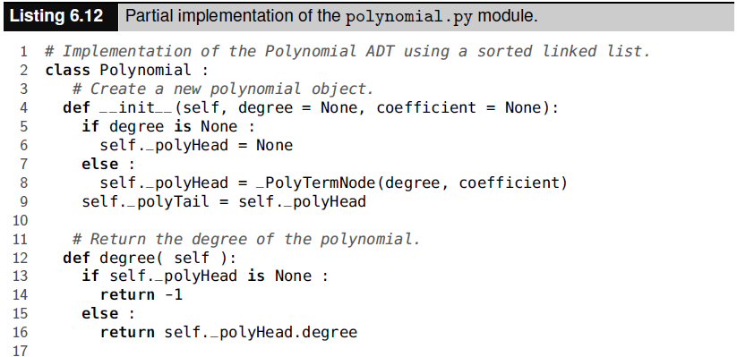
Polynomial : Implementation

Slide 43
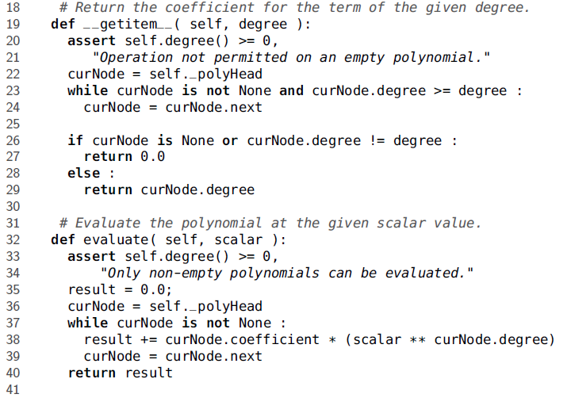
Polynomial : Implementation

Slide 44
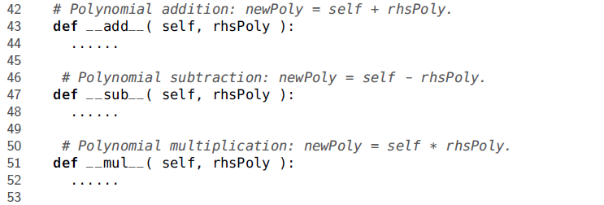
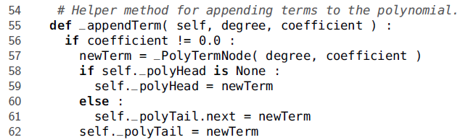
Polynomial : Implementation

Slide 45
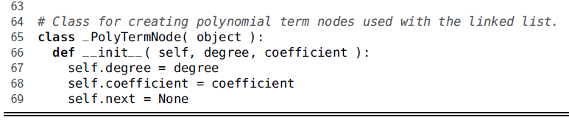
Polynomial : Implementation

Slide 46
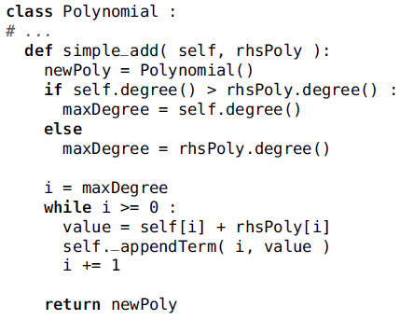
Polynomial: Addition

Slide 47
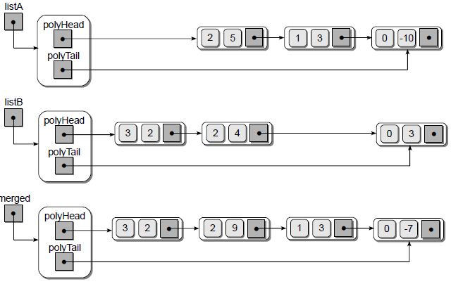



Polynomial: Addition
$$5x^{2}+3x−10$$
$$2x^{3}+4x^{2}+3$$
$$2x^{3}+9x^{2}+3x−7$$

Slide 48
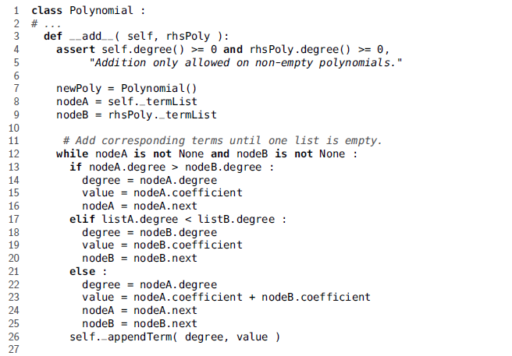
Polynomial: Addition

Slide 49
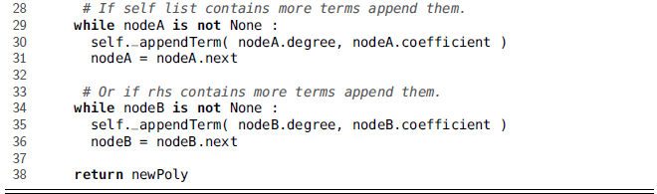
Polynomial: Addition

Slide 50
Polynomial: Multiplication
Computing the product of two polynomials requires multiplying the second polynomial by each term in the first.
This generates a series of intermediate polynomials, which are then added to create the final product.

Slide 51

Polynomial: Multiplication

Slide 52

Polynomial: Multiplication

